Slide 1
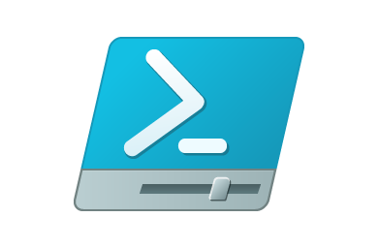


PowerShell Jobs
Demystified
Presented by: Mike Roberts
@gngrninja
www.gngrninja.com

Slide 2
What are PowerShell Jobs?
Jobs create child instances of PowerShell
These instances are spawned from and attached to your current session
Jobs are commands that run in the background
Child instances of PowerShell run your command, and the data regarding the state and any returned information is stored in the job
Follow along CODE: https://github.com/pdxpowershell/PUGDemos presentation.ps1

Slide 3
Why use PowerShell Jobs?
The shell is freed up for your use as jobs run
You can continue working in your shell as jobs execute
Jobs offer a way to monitor script execution
You can use a loop to monitor the state of jobs, and handle getting information from them

Slide 4
Downsides
If your session closes, so do all your jobs started with Start-Job
If you want to start jobs later that persist across sessions, check out Scheduled Jobs with PowerShell.
Error handling is a bit trickier than normal, but not impossible
Getting started can be tedious

Slide 5
PowerShell Job Commands
Start-Job
Get-Job
Receive-Job
Stop-Job
Wait-Job
Remove-Job

Slide 6
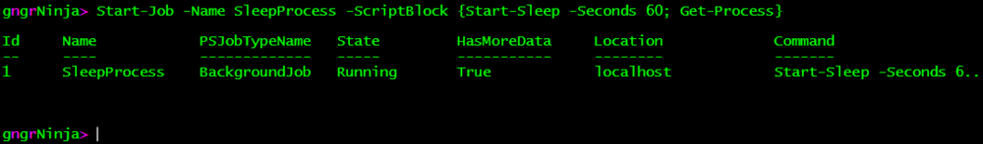
Start-Job
This command is what kicks it all off
Typical parameters:
-Name
Giving your jobs descriptive names will help you out in the future!
-ScriptBlock
Pass along the code you’d like to run, {surrounded by curly braces}
Example

Slide 7
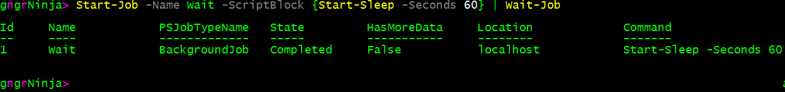
Wait-Job
Wait-Job holds up the shell until your job execution is complete.
It’s like using jobs while not benefiting from using jobs!
…but seriously if you need to iterate through commands and runs jobs sequentially this may come in handy
Even then, there are better ways you can do it
Typical parameters:
-Id
Pass along the job ID you’d like to wait for
-State
You can specify a particular job state to wait for
-Any
You can wait for any of the jobs to complete if you pass along multiple IDs
Example
Since this command accepts pipeline input, you can pipe Start-Job to Wait-Job

Slide 8
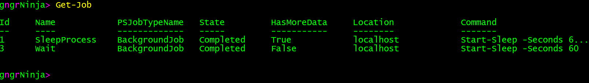
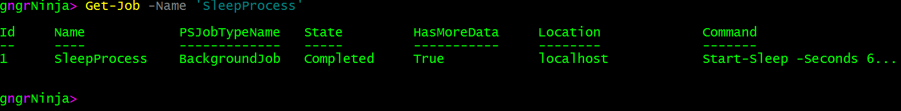
Get-Job
Get-Job retrieves a list of jobs and displays information regarding them
Useful for monitoring what is happening with your started, completed, and/or running jobs
Typical parameters:
-Id
Pass along the job ID you’d like to retrieve information about
-Name
You can also retrieve job information by the name you gave the job
Examples

Slide 9
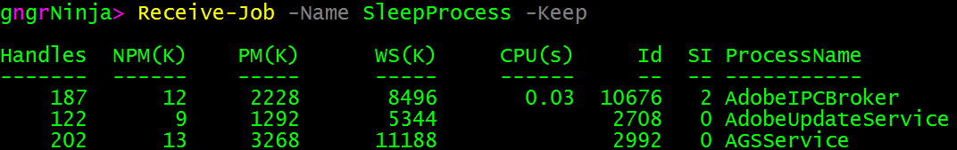
Receive-Job
Receive-Job will return the output of the command run by the job.
I recommend always using the –Keep parameter when starting out, or troubleshooting
Typical parameters:
-Id
Pass along the job ID you’d like to retrieve the output of
-Name
You can also retrieve the job’s command output by the name you gave the job
Example

Slide 10
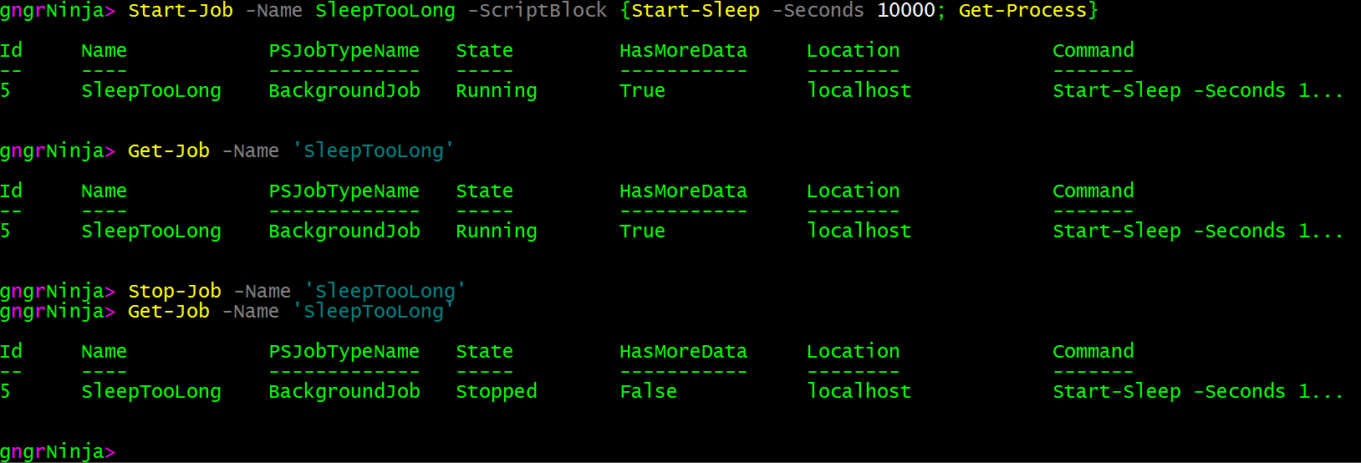
Stop-Job
Stop-Job stops a job from executing
This can be useful if a job has been running for too long
Typical parameters:
-Id
Pass along the job ID you’d like to stop the execution of
-Name
Pass along the job name you’d like to stop the execution of
-State
You can specify a particular job state you’d like to stop the execution of
Example

Slide 11
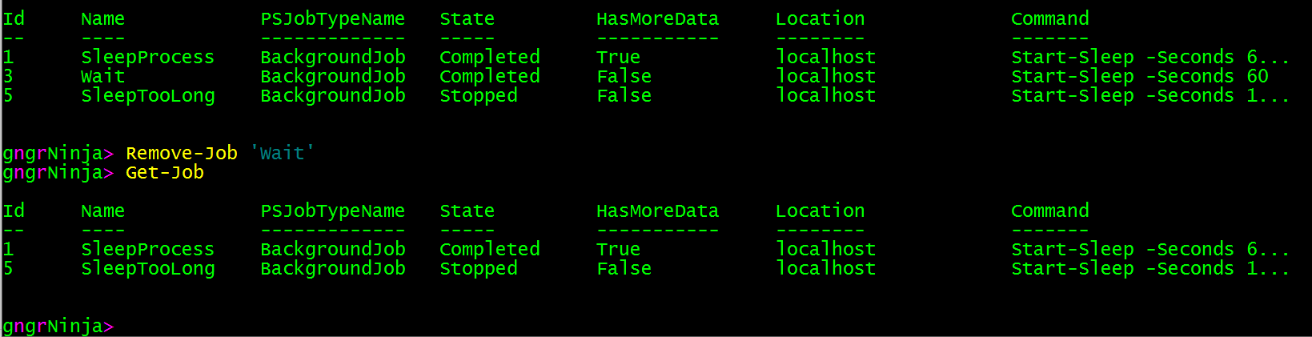
Remove-Job
Remove-Job removes the job and its information from the PowerShell session
The IDs of newly started jobs will still start at the next number of the last run job
The job(s) you specify to remove must be completed or errored out, not running.
If you want to both stop a job, and remove it, you can use the –Force parameter with Remove-Job
Typical parameters:
-Id
Pass along the job ID you’d like to remove
-Name
You can also remove a job by its name
-Force
This will remove jobs that are still in a running state
Example

Slide 12

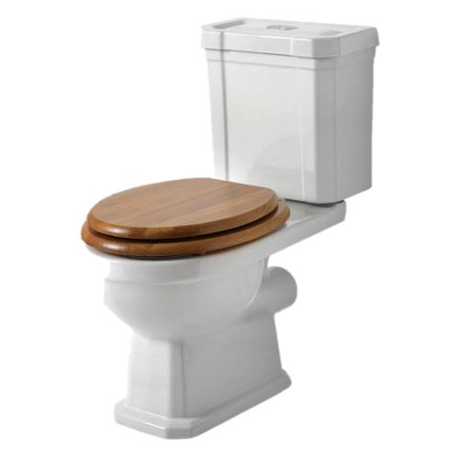
Bio Break, Questions?

Slide 13
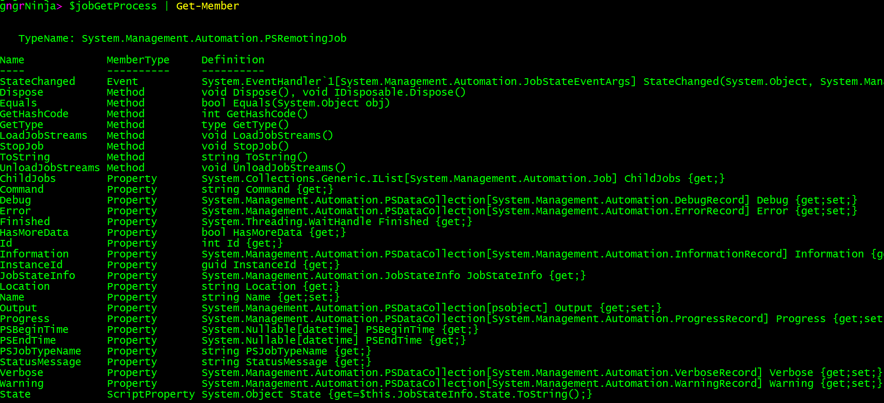
What Does a Job Look Like?
We can create a variable and store our job object inside of it
From here we can take a look at the properties and methods by piping our new object to Get-Member

Slide 14
Job States
NotStarted
Running
Completed
Failed
Stopped
Blocked
Suspended
Disconnected
Suspending
Stopping

Slide 15
Notable Properties
Id (The ID of the job)
Name (The name of the job)
State
ChildJobs
Each job has a childjob, and this is where the information is stored for the command that was run
PSBeginTime
PSEndTime

Slide 16
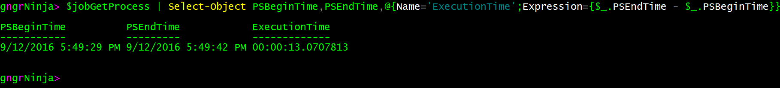
PSBeginTime and PSEndTime
These properties display the value of the time the job began, and the time the job ended
You can use it to calculate the job’s execution time, as seen below:

Slide 17
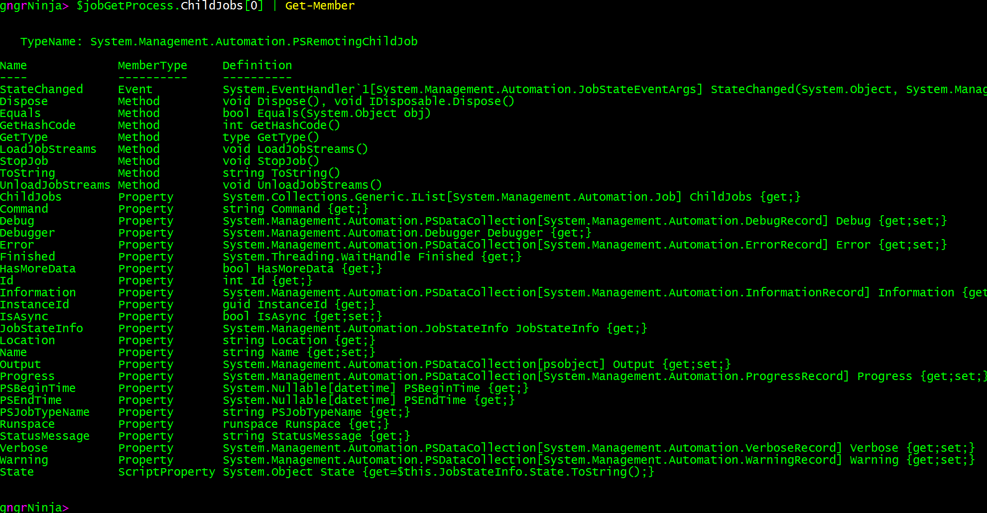

ChildJobs
This property(actually another object in and of itself) is perhaps the most important one
To see the information in it, specify .ChildJobs[0], and pipe that to Get-Member on the job object as seen below:

Slide 18
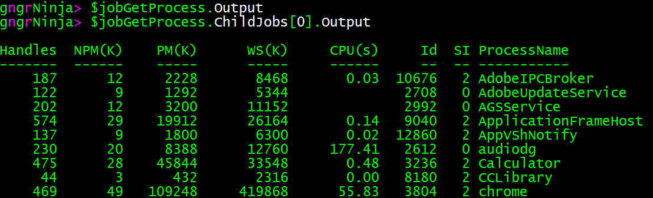
ChildJobs (Continued…)
The ChildJobs property actually contains the information of the command that was executed by the job
The Output property of our main job object is empty, yet the Output property of the ChildJobs[0] object will contain the command’s output

Slide 19
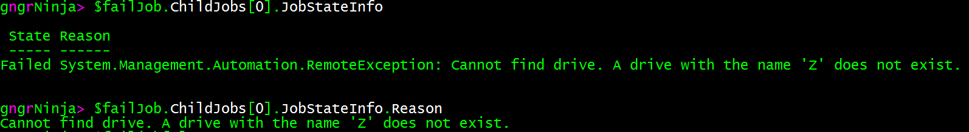
Failed Jobs
Jobs can and will fail
There are a couple distinct ways they can fail, and you’ll need to be thorough in hunting for errors at times
This is where you’ll need to use the ChildJob sub-object/property.
Job state information is stored in the property: $failedJob.ChildJobs[0].JobStateInfo
If you specifically just want the error you can use: $failedJob.ChildJobs[0].JobStateInfo.Reason
Example:

Slide 20
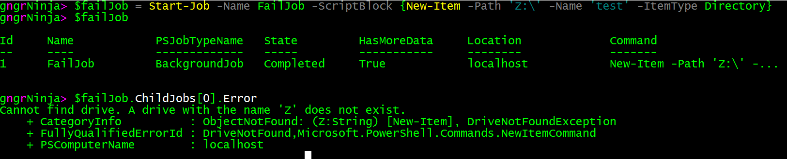
Failed Jobs (continued…)
Jobs can also fail with a completed state
It is good to add a check to see if this has happened to you
Error information is stored here: $failedJob.ChildJobs[0].Error
$failedJob.ChildJobs[0].Error.Exception contains the actual exception thrown
Example:

Slide 21
Error Handling
To properly handle errors in jobs, you’ll need to be sure to enumerate them either way they can come at you.
Error information from a failed job
Error information from a completed (but really failed) job

Slide 22
Workshop!
Job execution handling
Start these three jobs:
As they execute, collect information from them (any output or errors)
Log the output
CODE: https://github.com/pdxpowershell/PUGDemos

Slide 23
Questions?
@gngrninja
www.gngrninja.com

